Slide 1


Lecture themes
Moving to manufacture
Ethics

Slide 2
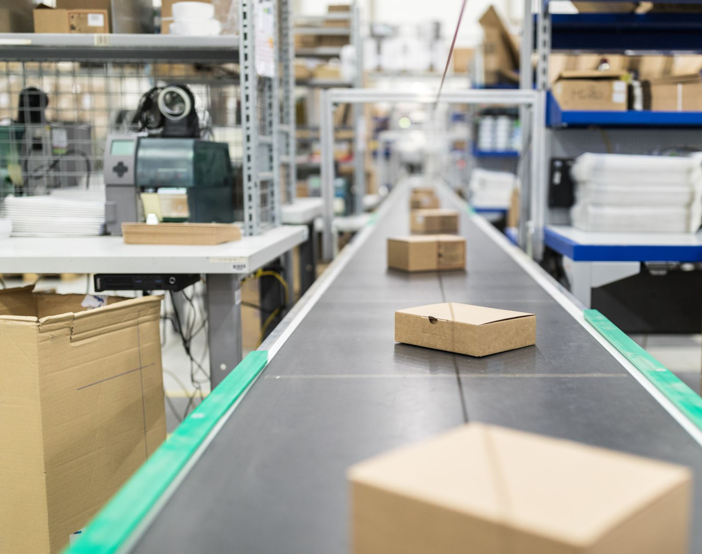
Moving to manufacture

Slide 3
Production
In previous lectures:
  Hardware/Software- Agents, AI algorithms, IoT, prototypes, business model
So, now, what should you do with the intelligent things you have built?
  Once the prototype is finished and the business model is ready, the next task is mass production.

Slide 4
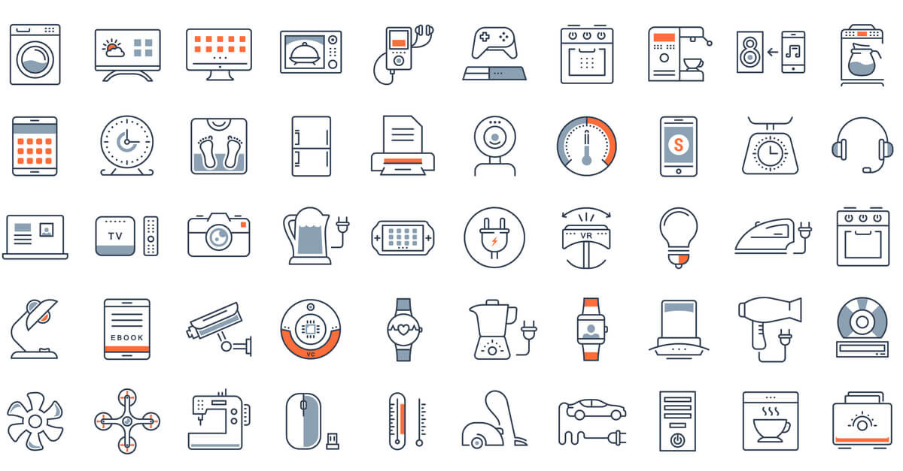
Production …

Slide 5
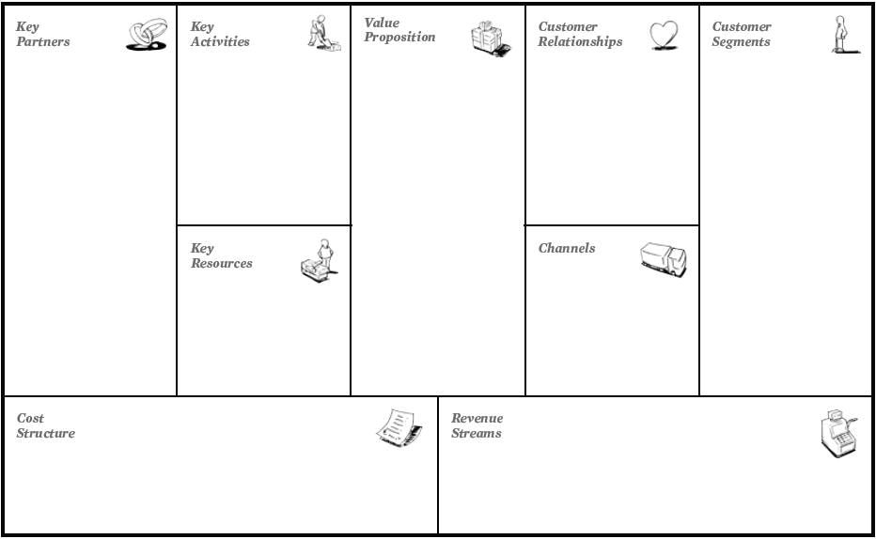
Production …

Slide 6
Production …
Issues to think about before launching the product :
  To mass-produce yourself or outsource the task.
  Certifications for safe goods? (trademark, etc.).
  Outlets, Packing, and Freight
  However, it is inappropriate to calculate sales price and budget assuming to solder PCBs in spare time.

Slide 7
Production …
An example of a modern Norwegian company that mass produces intelligent things:
  www.noisolation.com

Slide 8

Production goals
Before choosing a production method, think about your goal.
If the goal is not for profit:
  You might want to share the product with the outside world.
  So, just upload guidelines, source code and design files.
  This can be a nice resume if you want to apply for a job in related industry.

Slide 9
Production goals …
Some examples of sharing innovations on own blog or website
  www.instructables.com
  makezine.com
  hackaday.com

Slide 10
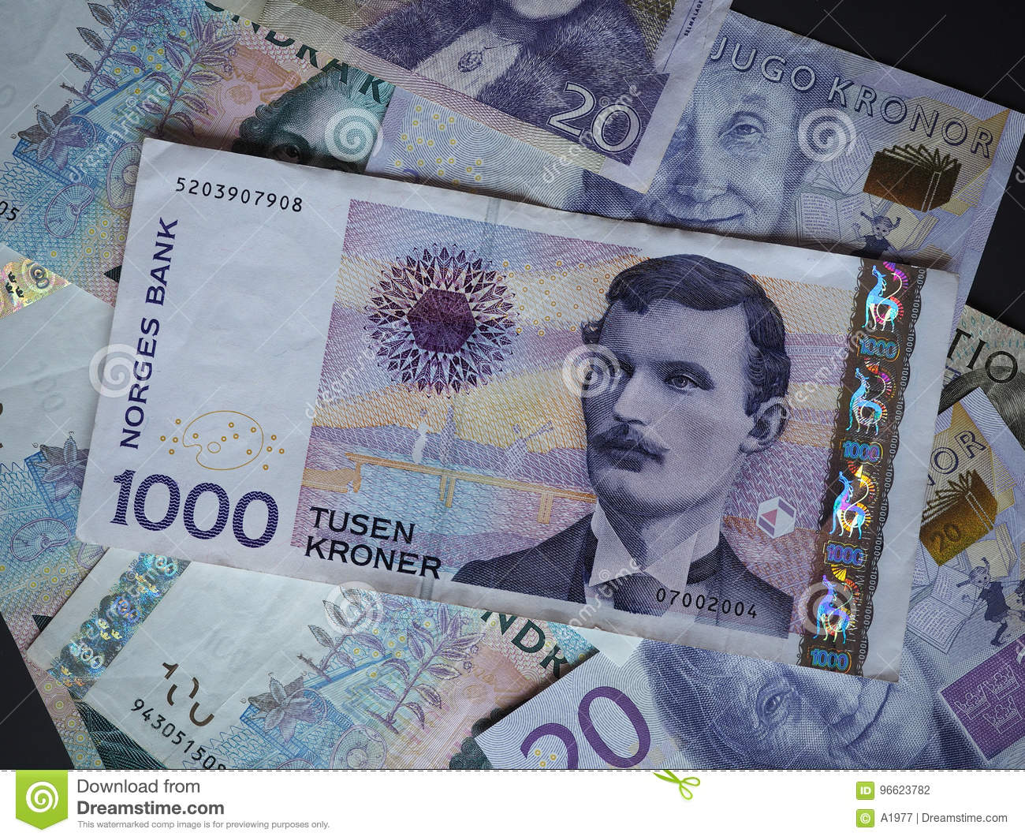
Production goals …
If the goal is to make money through consultancy or sells:
  the business plan and the model need to be reviewed
  the product or service quality must be refined
  time, money, and other resources required to produce are ready

Slide 11
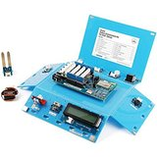
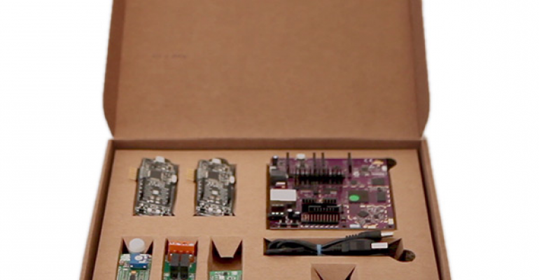
Production goals …
When selling a product, we still have more options:
  Building kits that customers can put together from scratch.
  Flat package version where customers assemble themselves.
  Finished composite item.

Slide 12
Pricing of built packages
As a basis for the price of a package, consider the costs for:
  parts
  assembling
  packaging
  shipping

Slide 13
Pricing of built packages …
As a basis for the price …
  Add the cost of the time you spend packing this together.
  Find a good base price
    Take into account costs not directly linked to replicating a product.
    E.g., offering a discount to retailers is a cost to be added.
  Before you finally rate, compare with similar products.

Slide 14
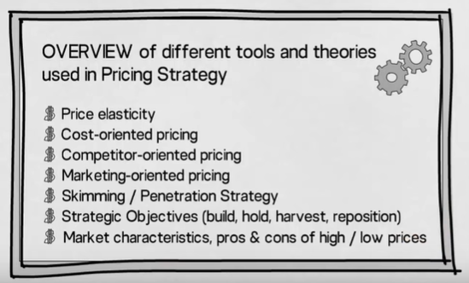
Pricing of built packages …
As a basis for the price …
  For more information- https://www.youtube.com/watch?v=mmm0ccYPliU

Slide 15
Mass production of frame (cover/body)
Frames can be produced using the approaches presented in the lecture on physical prototyping.
The most common way of building frames is through plastic injection moulding.
Frames can also be 3D printed, though it is much slower - also more expensive as the number of products increases.

Slide 16
Certification
A common shortcoming when selling intelligent things is to forget the need for certification.
If the circuit board, components or software is missing, it is obvious that something is wrong.
But, lacking certification is not easy to detect right away.
Certifications are intended to protect users by enforcing safety standards as specified in the product’s certification.

Slide 17
Costs and time frames
Mass production is more than price and speed to get started.
  It is about continuous delivery in large quantities.
Costs and time frames
  It may take days to produce a PCB- from design to receiving product
  The price can be from a few thousand NOK up to approx. ten thousand.
  The time it takes to make a mould for plastic frame can even be longer ...
  Certification cost may vary depending on requirements of the product.

Slide 18
Costs and time frames …
Example, manufacturing PCB

Slide 19
Ethics

Slide 20
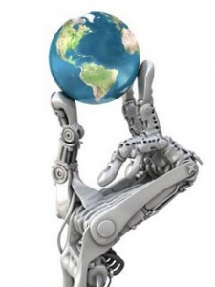
Technology = power?
Technology can provide endless opportunities you never imagined.
However, innovations in technology sometimes result in less good solutions.
As technologists, engineers and inventors, we have a responsibility in relation to what we contribute.
"With Great Power Comes Great Responsibility"- Spider-Man's Uncle Ben.
Notes:
shattered = crushed

Slide 21
Technology …
The pessimist might say that technology:
  Distances us from old traditions
  Removes jobs
  Is intrusive (invasive), and enslaves us (e.g., social media, games)
  Makes us slower and more unhealthy

Slide 22
Technology …
Rather, the optimist says that technology:
  Is new and exciting
  Is progression (implied improvement)
  Saves lives and makes the world better
  Make us happier and healthier

Slide 23
Technology ...
A stand point towards or away from a notion of "the good life”:
  Technology will lead to downfall of man! or make us fully realized!
As a rough division:
  One can either be in support or against technological innovations.
The position may depend on the subject area:
  E.g., pro computer innovation, but against genetically engineered food.

Slide 24
Privacy
There have been major changes in digital comm. in our time.
  So, what we do in the real world is shared with the virtual world, at about the same time- e.g., Facebook, Twitter, ...
There are changes to what was previously viewed as privacy:
  Everything you write online can now be seen anywhere in the world.
  E.g., the breakfast you ate, professional blog posts, and to whom you hangout in the evenings.

Slide 25
Privacy ...
There are benefits to being more visible:
  What you put online helps to define you as a competent person.
But, there is uncertainty to that:
  Do you want anyone to find information about you?
  E.g., upcoming employers, insurance agencies, criminals, ...
How about in a few years later?
  History is there even if you change your political stance, religion, orientation, circle of friends, ...

Slide 26
Privacy ...
Modern solutions like IoT things store lots of metadata about us.
Example of such information include:
  Pictures taken with mobile camera often contain GPS coordinates
  Same goes for devices that automatically upload your training track to Facebook, etc.
If someone wants to monitor you, they now get a relatively easy job of mapping- e.g., Burglars checking Facebook.

Slide 27
Privacy ...
Sharing with friends (about where you are and what you do) is OK but sharing to the whole world is something else.
A lot of data related to apps and IoT things is poorly secured!
So, as developers, we have a duty to ensure security on the data we store and or not to store more data than what we disclose.

Slide 28
Privacy ...
Example, ensure that our intelligent home monitoring system does not accidentally collect video and neighbour information, etc.
Ensure that we follow privacy/data storage laws and regulations.
  E.g., in the case of a security- Who owns the data from a security camera? Can they be freely sold to others?

Slide 29
Control
You feel safe when you share photos and data with others.
But, what if you see that photos and data you really want to keep private are shared for you?
So, ​​do others post something that feels personal to you?
What if in the future it becomes common to sell data for profit to authorities or business firms?

Slide 30
Control ...
Crowd sourcing is a popular solution to control information (e.g., Wikipedia) or financing (e.g., Kickstarter).
Within IoT, sensor networks that operate according to this model are conceivable.
Often this can be used for good cause- data collection and analysis to inform about a condition (e.g., pollution), etc.
But, it's easy to imagine that this data can be misused as well and hence need to be controlled- e.g., illegal surveillance.
Notes:
the practice of obtaining information or input into a task or project by enlisting the services of a large number of people, either paid or unpaid, typically via the Internet.
"crowdsourcing is less expensive than hiring a professional translator"

Slide 31
Environment
Developers of IoT things need to make an ethical assessment in relation to the environmental impact.
How much do we pollute through our process of mass production of IoT things? Do we destroy jobs?
It may probably be okay to pay a little more to improve the production process.
However, is it okay to pay a fee or fine to avoid improving the process?

Slide 32
IoT gadgets
Creating IoT stuffs often costs more for the environment than making other stuffs because we fill things with electronics, etc.
  The pessimist may say that we contribute to environmental degradation.
  But the optimist would argue that IoT things help to make a better world.
In general:
  Remember that you may not be concerned about sharing personal data or environmental challenges, but it can be important to others.

Slide 33
Mentimeter discussion points
What is mass production?
What are the issues we need to consider before launching the mass production?
Why are we concerned about ethics in relation to intelligent systems? Debate on issues in support or against intelligent agents.
Explore and discuss any scary or adventuresome stories about intelligent things/robots?

Slide 34

Next topic
Rehearsal- and preparation for exam

